Slide 1
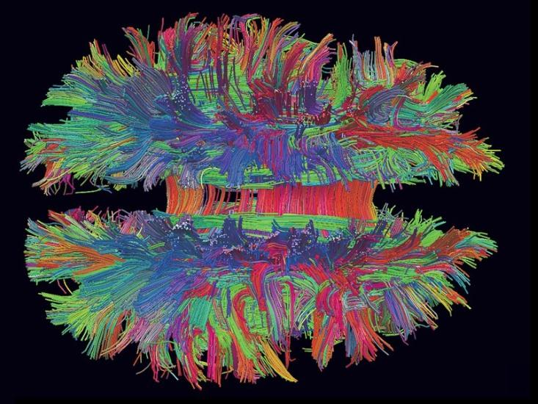
The Neuroscience of Emotions Part 2
Sangeeta Das Bhattacharya MD,MPH
School of Medical Science and Technology IIT Kharagpur

Slide 2
Neuroscience of Emotion Part 2
2 Theories
Classic Theory
Theory of Constructed Emotion
2 Large Networks of Neurons
Interoceptive Network
Control Network

Slide 3
Human Brain
86 billion neurons
Connected in massive networks
Never lies dormant

Slide 4
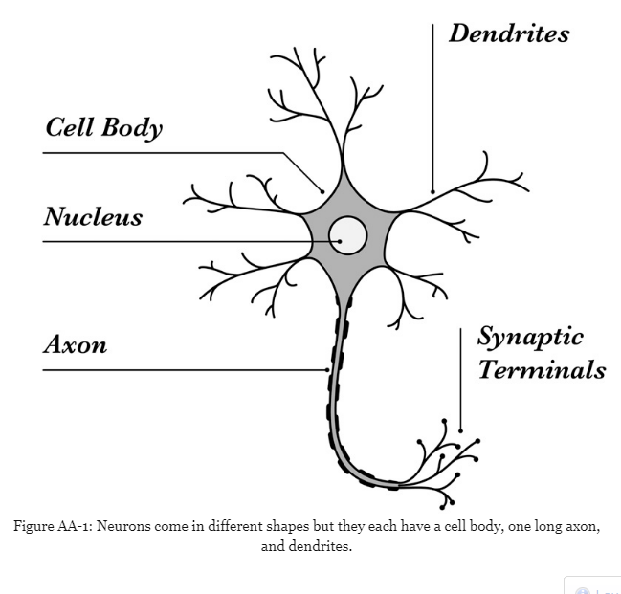

Slide 5
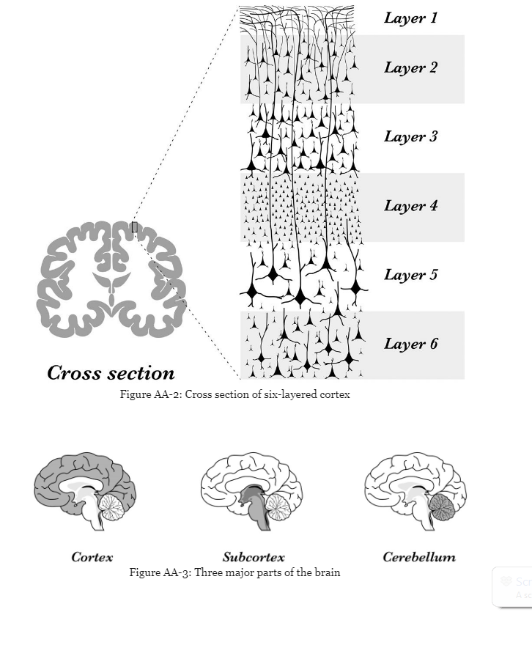

Slide 6
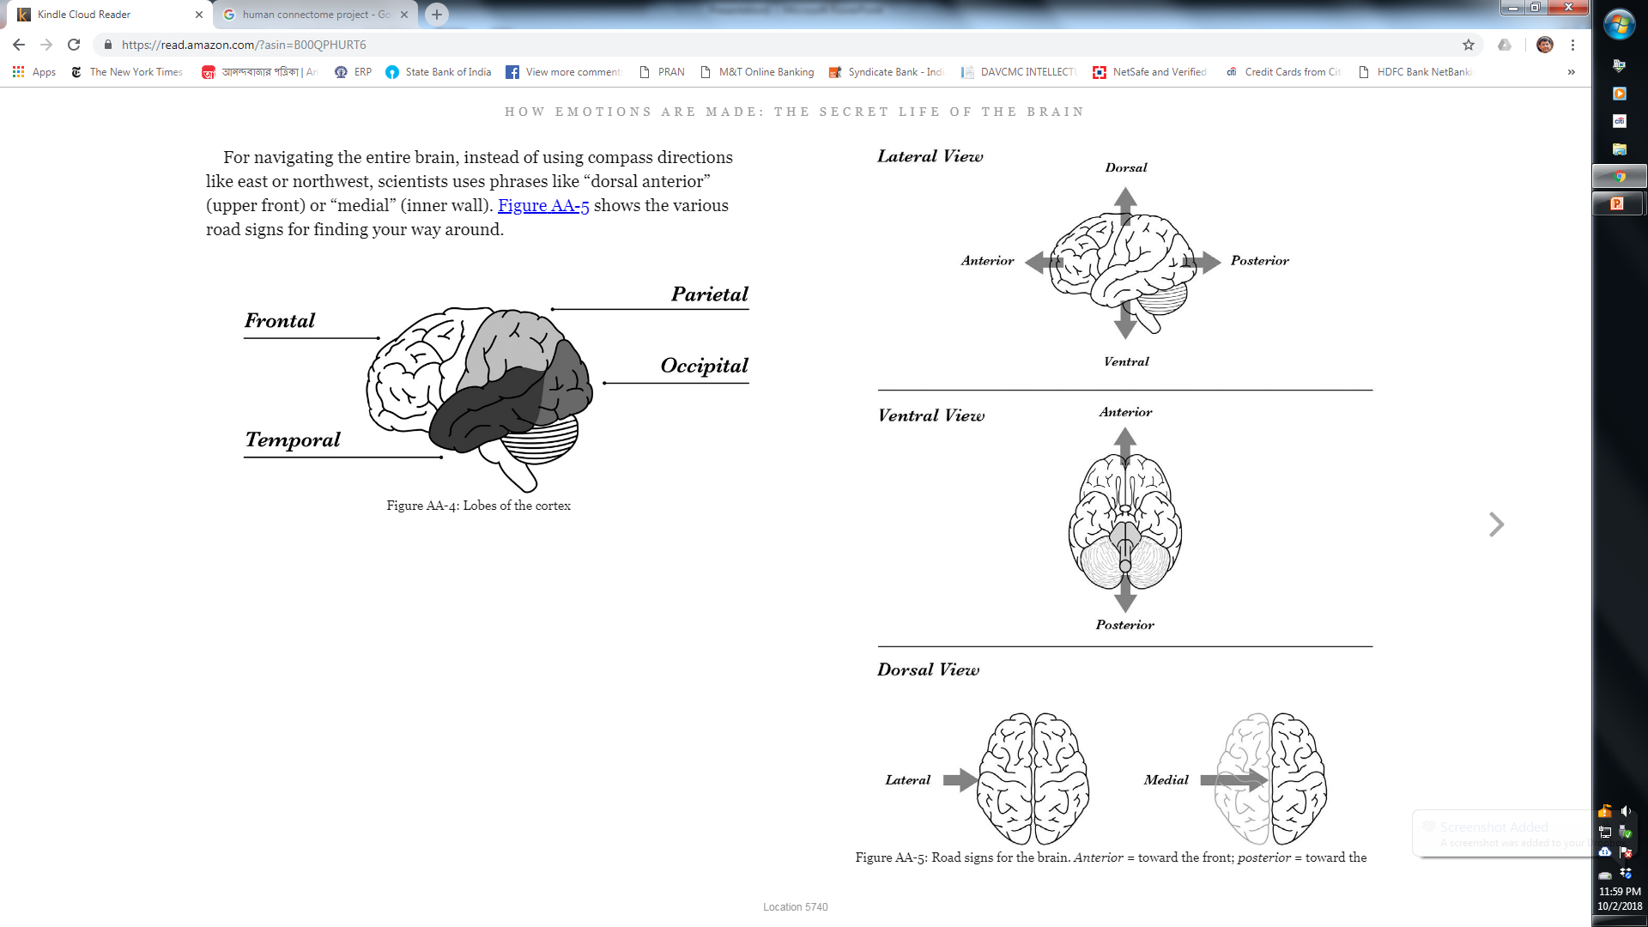

Slide 8
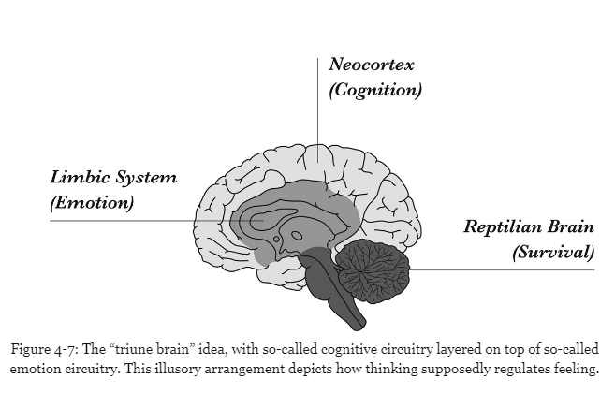
Out dated view of the brain

Slide 9
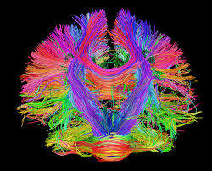
The Brain:
Billions of Prediction loops creating intrinsic brain activity

Slide 10
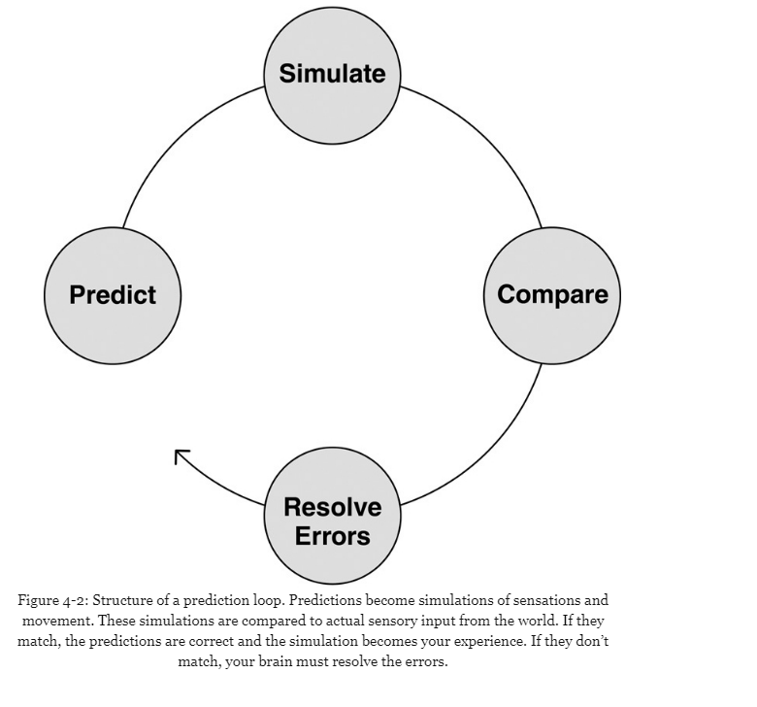

Slide 11
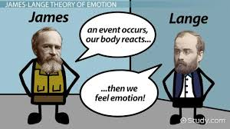
The Classic Theory
Events in the world trigger emotional reactions inside of us, thoughts and feelings live in distinct brain areas.

Slide 12
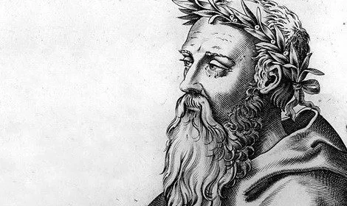
Scientific Tradition of Construction
No man steps into the same river twice.
Heraclitus c 540 BC, Ephesus
(Pre-Socrratic philosopher)

Slide 13
Construction
Your experiences and behaviors are created in the moment by biological processes within your brain and body.
Memory
Perception
Mental Illness
Emotion

Slide 14
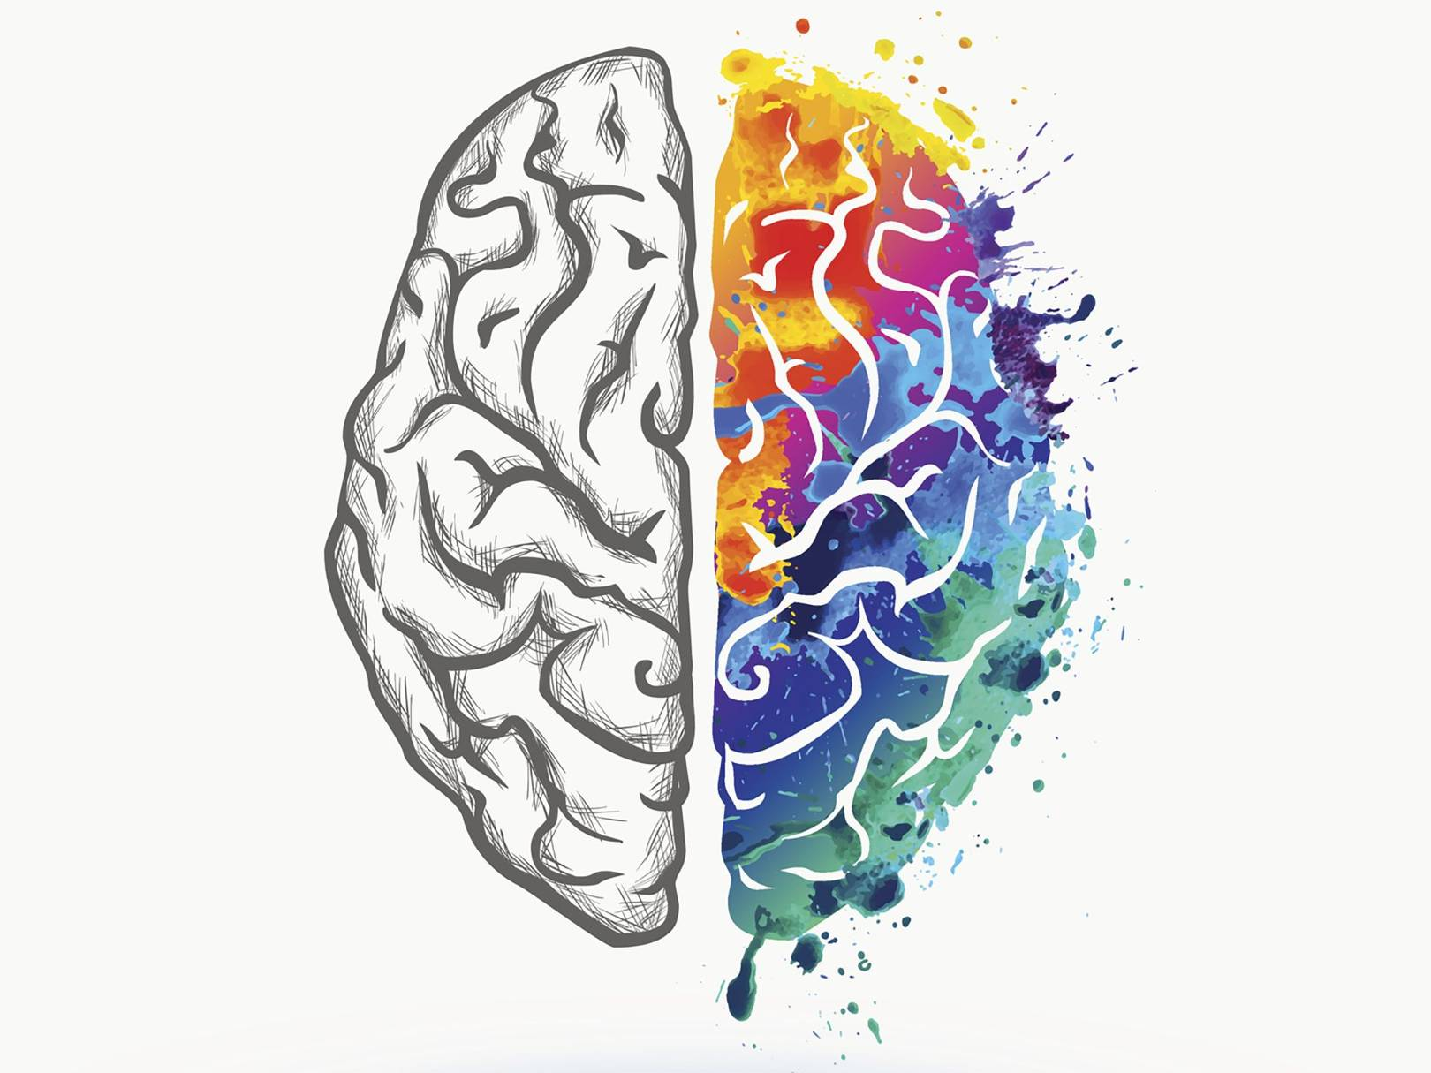
Theory of Constructed Emotion
Your brain constructs everything you experience including your emotions.

Slide 15
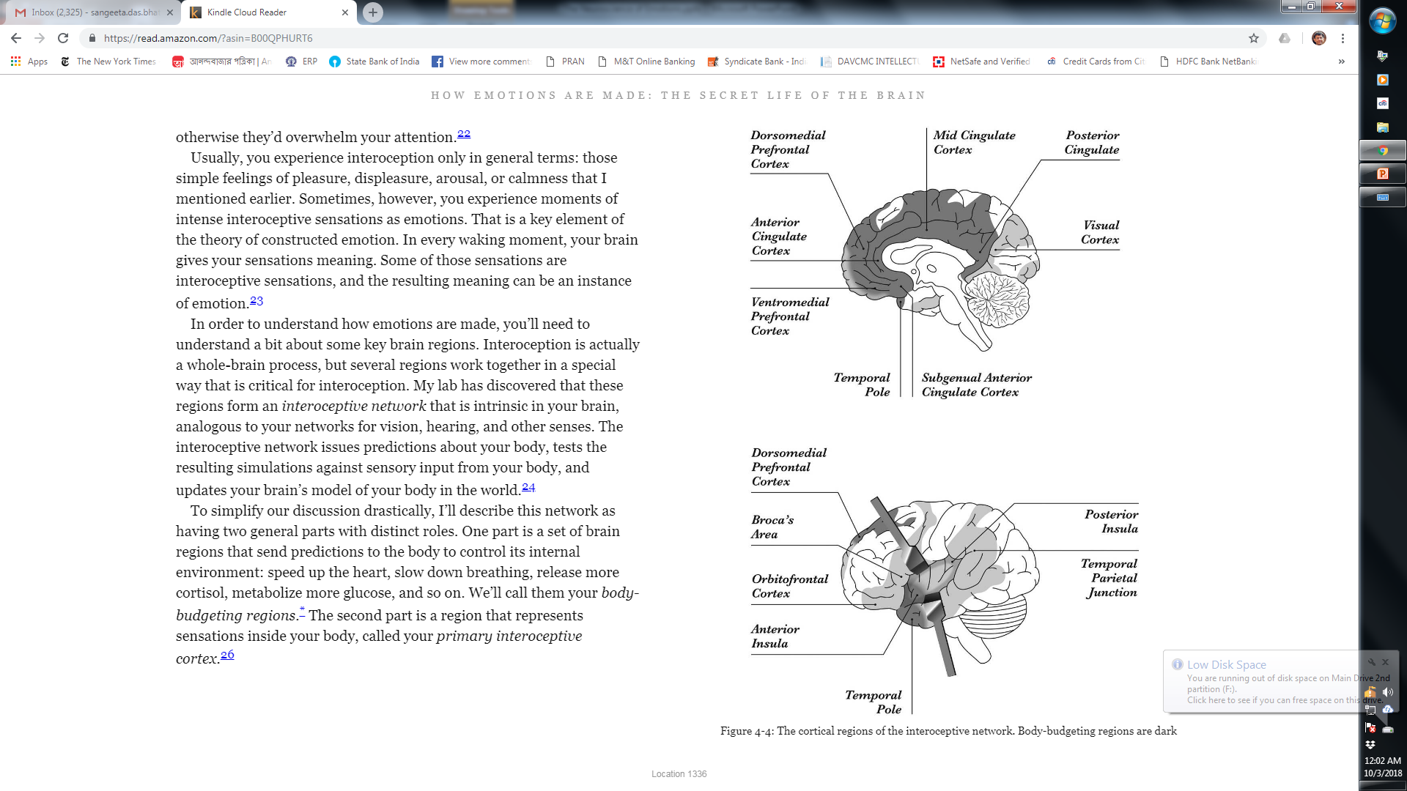
Interoceptive Network

Slide 16
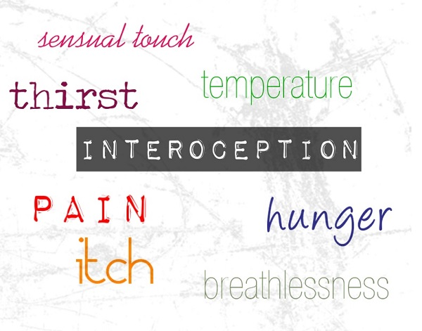
Interoceptive Network
Interoception is the brain’s representation of all sensations from the body, your internal state
Issues predictions about your body
Tests the resulting simulations
Updates the brain’s model of the body in the world
https://musingsofanaspie.com/2013/07/03/interoception-how-do-i-feel/

Slide 17
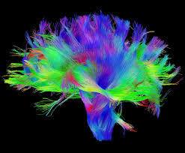
Control Network
Tinkers with information flow which moves sensory information in and out of the spotlight making some predictions fit and finding others irrelevant.

Slide 18
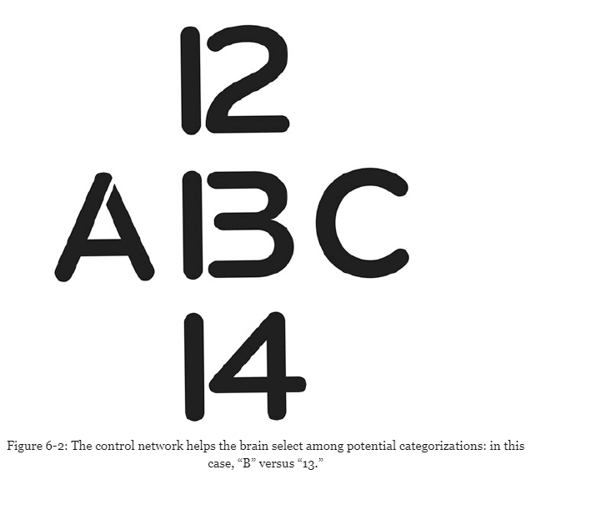

Slide 19
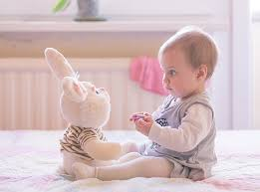
Emotion Concepts are Constructed

Slide 20
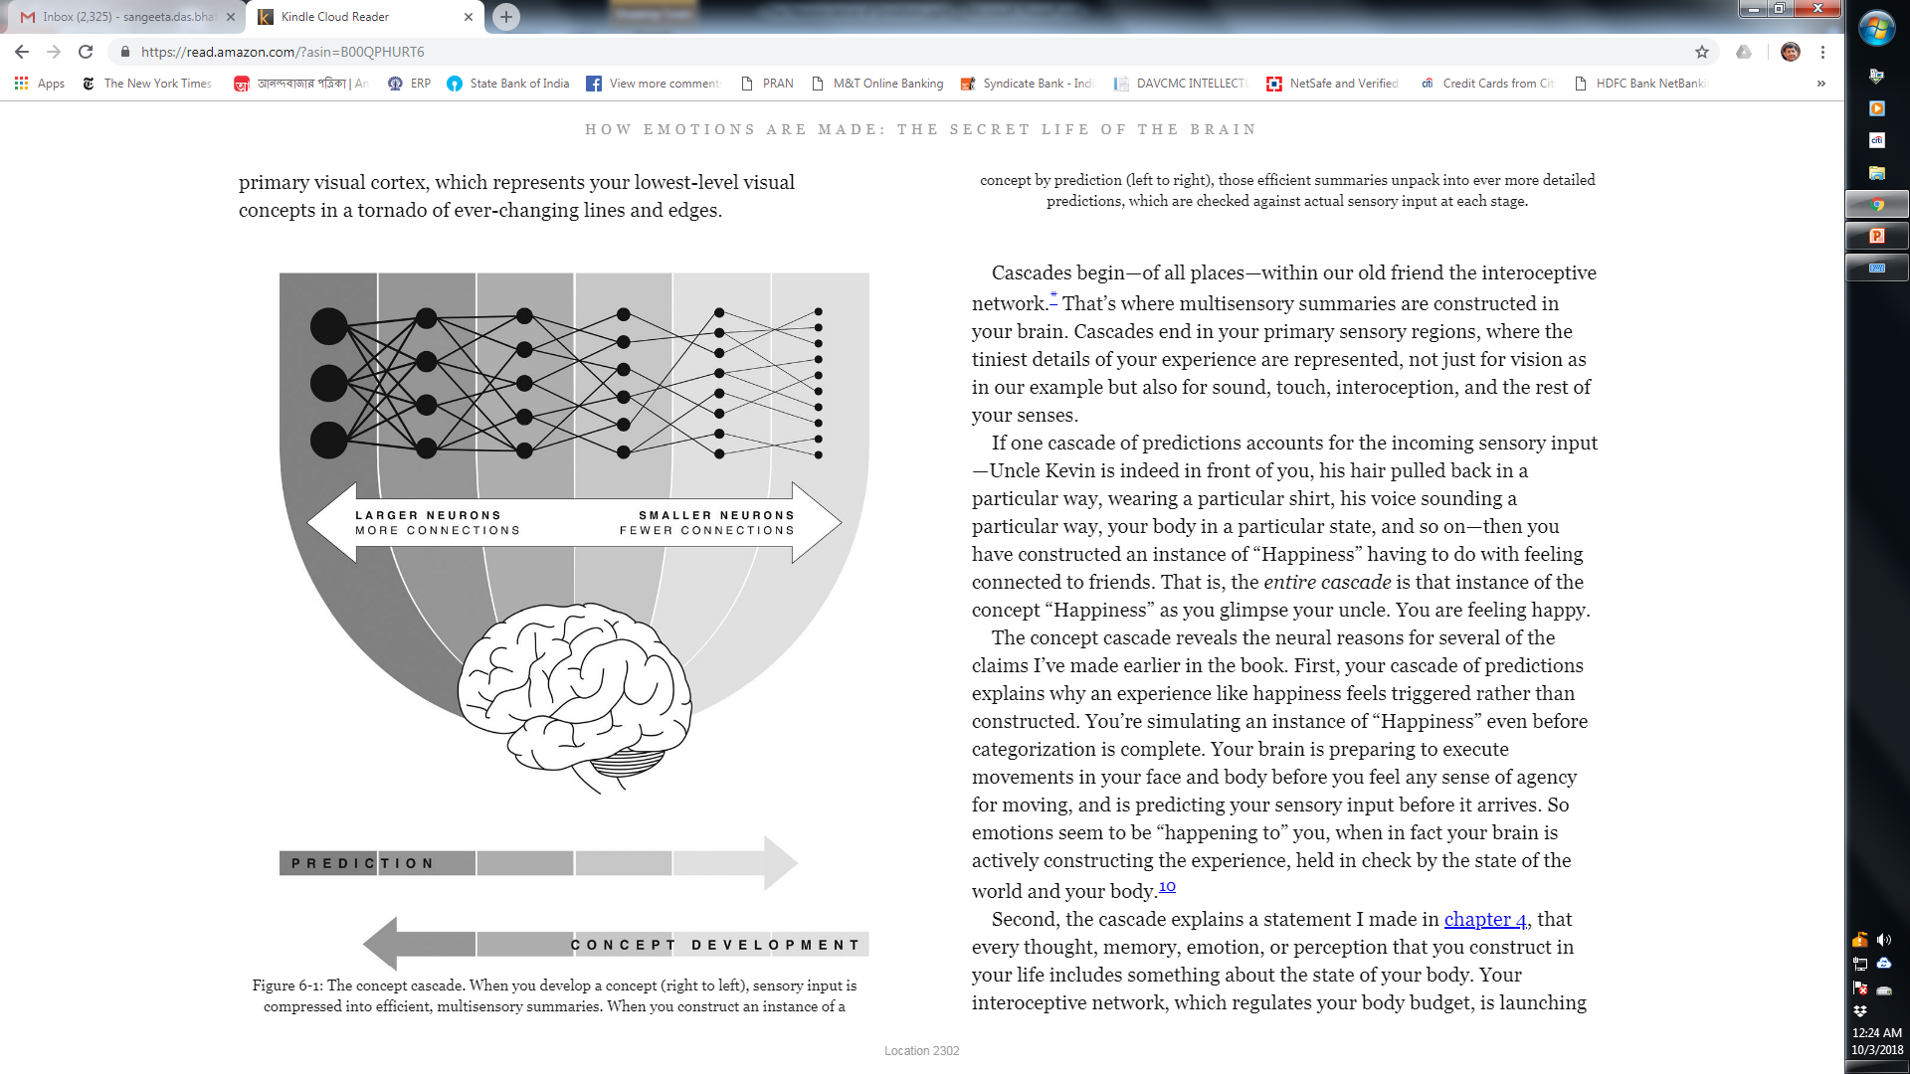
Concept Cascade
represented by words

Slide 21
Happiness

Slide 22
Age-otori

Slide 23
Age-otori
The feeling of looking worse after a haircut -Japanese

Slide 24

Gigil

Slide 25
Gigil
The urge to hug or squeeze something that is unbearably adorable
-Filipino

Slide 26
Concept Cascade
Concepts are biologically wired into your brain

Slide 27
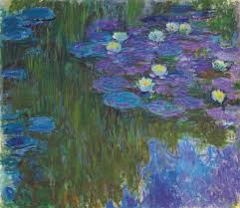
Emotion Concepts
Make Meaning
Prescribe Actions
Regulate your body budget

